Slide 1
Credit Scoring Project for ABC Bank

Slide 2
Business Case: Credit Risk Modelling
ABC Bank Ltd. intends to build an in-house risk model to make lending decisions for subprime mortgages
Business objective is to maximise profitability, given:
Profit from a good customer is $100
Loss from a bad customer is $500
Bank has shared historical data on customers’:
Credit bureau records
Loan outcomes (paid off or bad loan)

Slide 3
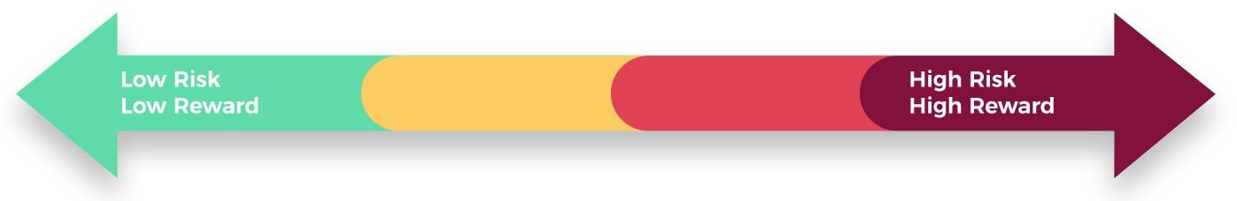
Our understanding of the assignment
Public Bank (SBI)
Private Bank (ICICI)
ABC Bank Ltd is positioned here
New Entrant (Bajaj Finserv)
Risk Minimization |
Profit Maximization | Market Expansion
Credit Scores - High
Subprime Credit - No
Credit Scores - Optimal
Subprime Credit - No
Credit Scores - Low
Subprime Credit - Yes

Slide 4



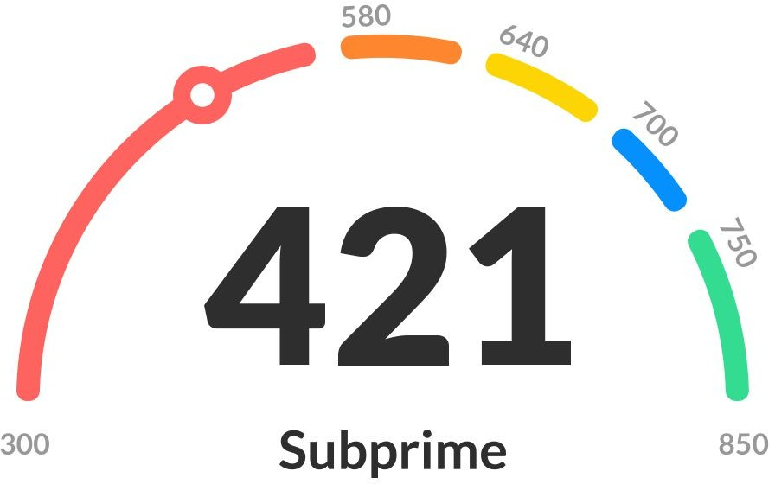
High-level solution architecture...
Lending Decision
1 0
Risk ML Model
~80%
Logistic Regression
Labelled Historic Data on Credit
Training Set
Lending Decision Predictions
Decile Methodology
~20%
Test Set

Slide 5


Our approach
Assumptions
missing values imputed with mean
customer ID excluded from analysis
Trained a classification model, for
predicting likelihood of loans being good/bad
using Logistic Regression Classifier

Slide 6


Deliverable #1: In-house Risk Model
83%
Model accuracy achieved
Zero
Operational Cost to Business

Slide 7


ABC Bank’s Lending Strategy: Options
% of Good Loans predicted correctly
% of Bad Loans predicted correctly
Probability Threshold for Approvals
67%
74%
85.47%
79.73%
Strategy for Profit Maximisation
77%
62%
Strategy for Profitability-cum-Market
Expansion

